Slide 1
How Can a Wellness Technology Company Play It Smart?
Yousef Elbayoumi
November 2022

Slide 2
Problem:
Solution:
What are some trends in smart device usage?
Work on the data from the FitBit fitness tracker, analysing it carefully, and apply the data analysis six steps. Looking for correlations, outliers, similarities and differences.

Slide 3
Analytical goals
WHY: People are less healthy
HOW: Time people spend in bed awake

Slide 4
Analytical goals
WHY: People are less healthy
HOW: Time people spend in bed awake

Slide 5
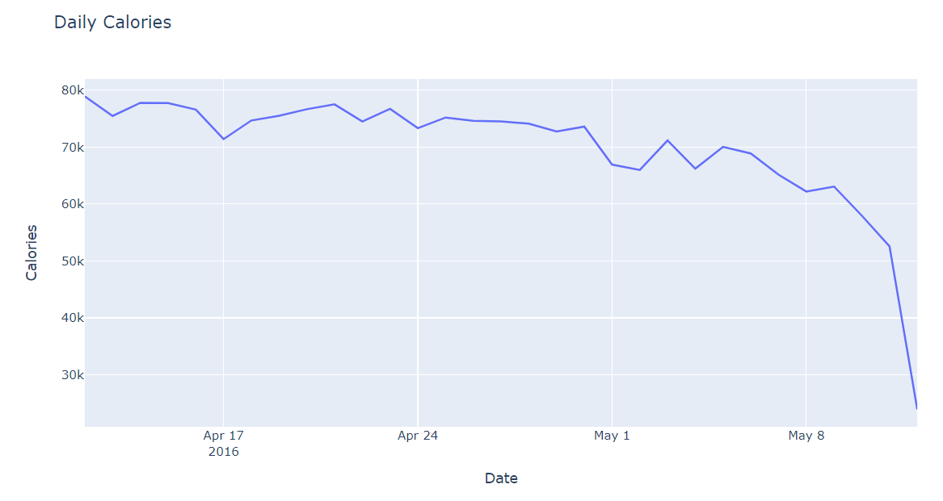
Downward Trend
Burned calories has significantly decreased since 5th of May
Source: Data from the FitBit fitness tracker (CC0: Public Domain; made public through Mobius)

Slide 6
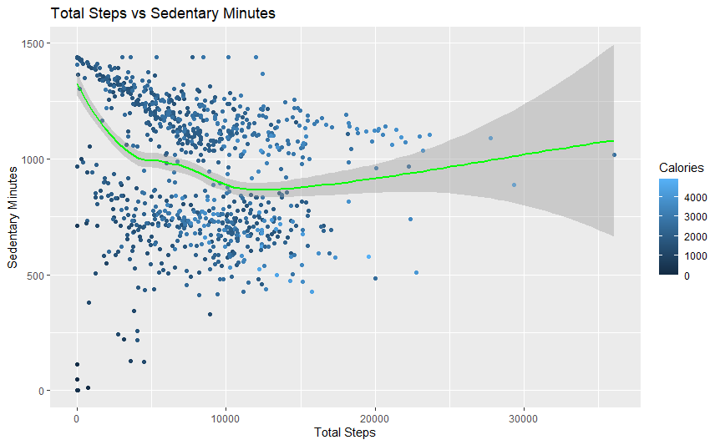
The Reason
The relationship between total steps and sedentary minutes is inverse at first when there are fewer than 10,000 steps done.
Source: Data from the FitBit fitness tracker (CC0: Public Domain; made public through Mobius)

Slide 7
Thus, we need to get people to start moving more and taking more steps.

Slide 8
Analytical goals
WHY: People are less healthy
HOW: Time people spend in bed awake

Slide 9
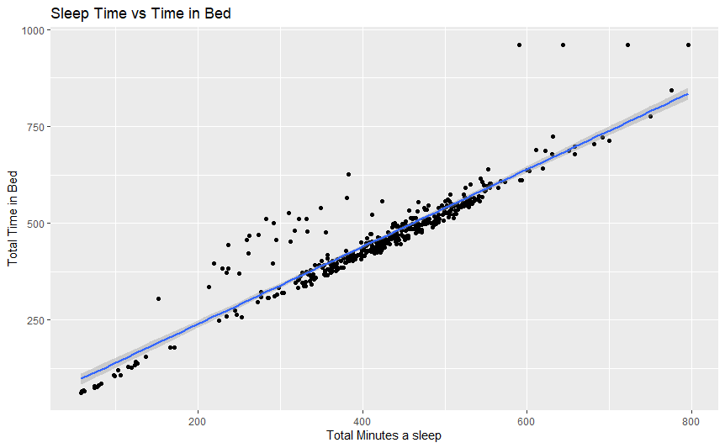
Sleep Time vs Time in Bed
The correlation is approximately 93%
Those who spent a lot of time in bed but didn’t sleep are the outliers.
There may be a variety of causes behind that.
Source: Data from the FitBit fitness tracker (CC0: Public Domain; made public through Mobius)

Slide 10
Thus, we should design our wellness technology to ensure the difference between sleeping in bed and staying awake in bed.

Slide 11
In Summary
WHY: Getting people to start moving more.
HOW: Differentiate between sleeping in bed and staying awake in bed.

Slide 12
Thank You.

